Slide 1
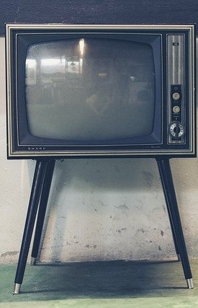
LECTURE nine: digital television
ET 8105 – Television Systems

Slide 2
Introduction
The television system in which analog audio and video signals are converted into digital binary pulses for transmission, and after detection at the receiver are reconverted into analog signals for being reproduced as original sound and picture, is called digital television or simply DTV.
Naturally, a question arises as to what is the need of this exercise of first digitizing and then negating the process.
The answer lies in some very important advantages the process provides to the user at quite a low cost

Slide 3
Advantages of Digital TV
Picture Quality
Noise is small
No Ghost image
Flicker removed
High definition pictures can be easily achieved

Slide 4
Special features available in DTV
Picture in picture (PIP) and Picture and picture (P&P) – viewing multiple inputs on a TV screen
Freezing of frame
TV games can be operated
All the processing functions can be software controlled
Teletext reception can be incorporated in TV receivers
View data can be provided
Interaction between end user and broadcaster for pay TV
Reduced bandwidth
Multiplexing of programmes on the same channel

Slide 5
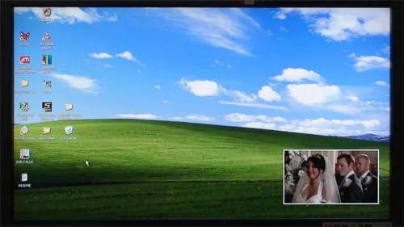
Picture in picture

Slide 6
Special Effects available in digital television systems
Editing
Zooming
Blasting – Camcorders can zoom any part of the picture for recording and subsequent display
Pixelation
Wide dimension TV (WDTV)
High Reliability
Due to the use of digital ICs, reliability can be very high.
The ICs have also brought down the cost substantially
Availability of video telephone and video conferencing

Slide 7
Disadvantages
High bit rate requires compression before transmission and decompression at the receiver
Compression/decompression sometimes causes a small noise, called mosquito noise
In analog system, the quality degrades gradually, but in digital system the picture quality remains good till a certain C/N ratio, but below that it degrades very rapidly.
This problem has been tackled by using correcting codes, and by incor-porating intelligence in the decoder circuit so that it may make an intelligent guess and replace the faulty block of codes by new blocks containing a guessed picture.
The advantages however outweigh all the mentioned difficulties

Slide 8
Digital Baseband Signal
Digitisation of analog baseband signal is achieved through the following steps:
1. Sampling of analog signal
2. Quantization
Sampling - Continuous analog signal is sampled at the rate equal to or higher than twice the maximum frequency of the baseband signal.
Twice the highest frequency is called Nyquist frequency.
It was established by Nyquist that if the frequency of sampling is less than twice the highest frequency of the baseband signal, it cannot be restructured at the receiver in the original form.
Severe distortion will be inducted in the signal.

Slide 9
Quantization - Sampling although discrete, still gives an analog signal, because the discrete values vary indefinitely with the signal.
To make it digital, the sampled values should be converted into streams of binary numbers, 1s and 0s, called logic numbers.
This process of converting sampled values into binary numbers is what is being referred to as quantization
The process of sampling and quantization is called digitisation or analog to digital conversion, and the device which executes this conversion is called analog to digital converter, or simply ADC.
Some control bits are added to indicate ‘Start’ and ‘Stop’ of a character.
Production of bits this way is called source encoding.

Slide 10
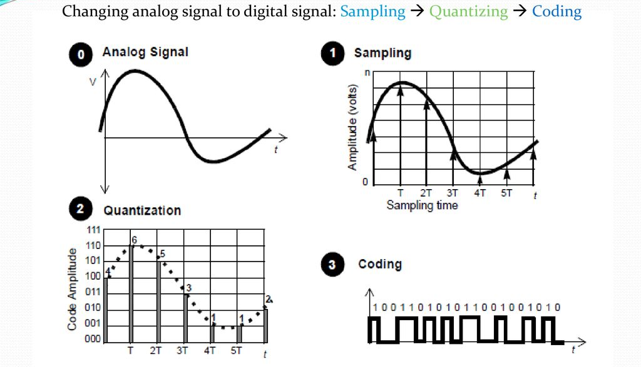

Slide 11
When the digitised signal is to be transmitted, a few bits are added to each character to detect errors caused in the process of transmission, and to correct the same.
The new stream of bits is called channel encoding.
At the receiver, the digitised signals are processed to get the original analog signals in the output, that is, sound from the loudspeaker and pictures on the screen, which are without noise and spurious effects.

Slide 12
Digital Video Production and Reproduction
The basic elements of a digital video baseband system are shown in the figure in the next slide
The analog video signal output of the camera tube and matrix consists of luminance signal Y and colour difference signals, U and V.
Although the composite video signal can be sampled at 10 million samples per second to effectively cover the video bandwidth of 5 MHz, but preferred method is to quantize Y, U and V signals separately to give three streams of bits (pulses) at the output of a fast ADC.
The quantized bits are recorded into the memory (field store) at 50 Hz field rate

Slide 13
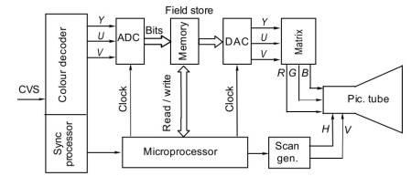
Digital video production and reproduction

Slide 14
For playback, bits are read from memory at 100 Hz and then converted from digital to analog from the DAC unit for display on the screen of a monitor, at double the line and field scan rates to give high resolution.
Digital pulses can be processed with the help of a microprocessor to incorporate many special features and special effects (described later), which were unthinkable in a fully analog video system.

Slide 15
Digital Picture Transmission and Reception
When the CVS produced by a camera tube is digitised, it consists of a high bit rate to describe the details of luminance and colours of every pixel.
This bit rate for normal quality pictures is 216 megabits per second.
HDTV produces even faster bit rate of 1200 megabits per second for European HDTV standards of 1250 lines, 50 fields, and 16:9 aspect ratio.
Such high bit rates can be handled in CCTV and studio, but they pose problems with broadcast systems.
It is necessary to reduce the bit rate and to adopt a suitable modulation system. Solutions are outlined hereafter:

Slide 16
Digital Compression
Reduction of bits is done by removing the bits which are redundant in a picture.
Most of the television pictures contain redundant information.
For example, there are stationary parts in a picture. A blue sky in a scene forms a still image and instead of sending it repeatedly, it needs to be sent only once.
It can be repeatedly read out from the memory store in the receiver to constitute the original scene.
JPEG, JPEG 2000, MPEGs compression methods developed by ISO/IEC and H.26x series developed by ITU.

Slide 17
Modulation Method for Digital Video
Digital data pertaining to control signals, video information and audio information are interleaved, in time.
The multiplexed pulses modulate a suitable carrier for transmission.
The method of modulation used in all the countries except north America is orthogonal frequency division multiplex (OFDM).
In this method a large number of closely spaced carriers are modulated individually and separately and then transmitted in a slot in the frequency spectrum.
The system is immune to noise and interference
USA and CANADA uses eight-level VSB (or 8 VSB) which requires low carrier power, but is prone to interference

Slide 18
Modulation Method for Digital Sound
In digital TV, audio signals are also digitised as illustrated in the next slide.
Stereo sound (or surround sound in more sophisticated TV) is used in digital TV systems.
The left/right sound outputs of a stereo amplifier are first pre-emphasized and then are passed to ADC units.
The upper limit of audio is restricted to 15 kHz and samples are taken at intervals of 31.25 μs (for 32 kHz clock rate, 1/32 = 31.25 μs)
Each channel is sampled to 14 bits which give 16 238 levels
Thereafter these bits are compressed adequately to save bandwidth.
One parity bit is added to each word to give even parity

Slide 19
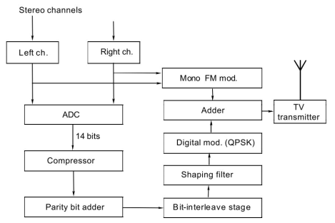
Block diagram of audio transmitter of digital TV

Slide 20
The modulation used is called digital quadrature phase shift keying (DQPSK).
In this system, the phase of the carrier has four possible states (0°, 90°, 180°, 270°).
A serial to parallel data converter changes the serial data into parallel data of 2-bit pairs (00, 01, 10 and 11).
Each pair shifts the phase of the carrier to different values.

Slide 21
Receiver for Digital TV
It is a superhetrodyne receiver.
The bundle of bits pertaining to sound and vision beats with the local oscillator and produces IF signals (video IF and audio IF).
A diagram for a typical receiver is given in the figure in the next slide
The tuner selects the desired channel
A sharp filter, separates the video IF and audio IF.
Video bits are detected and decoded to give the original samples after decompression.
These are converted into analog signal using a DAC

Slide 22
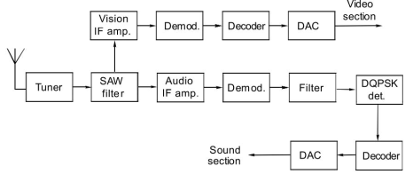
Block diagram of a digital TV receiver
Notes:
Surface Acoustic Wave Filters or SAW Filters are compact, low-cost RF filters that can be used in a wide range of applications up to 3 GHz.
SAW filters operate by converting electrical energy into acoustic or mechanical energy on a piezoelectric material.

Slide 23
For audio, IF is converted into inter-carrier frequency and the sampled audio pulses are obtained by using a DQPSK demodulator.
The demodulated pulses pass through a decoder and a DAC circuit to get the original audio signal.
Digital TV provides another feature known as picture-in-picture.
This feature is described in the next slides.

Slide 24
Picture-in-Picture Feature in Digital TV
A digital TV can incorporate an interesting feature of picture-in-picture (PIP) in a TV receiver.
This feature allows a smaller second picture (1/3 x 1/3 of the actual size) to be over-layed on the main picture in any of the four corners of the screen.
Composite video signals from two pictures pass through a colour decoder to give respective Y, U, V signals which are time multiplexed and pass through a digital processor.
The processor consists of an ADC circuit, a filter and a digital conditioner

Slide 25
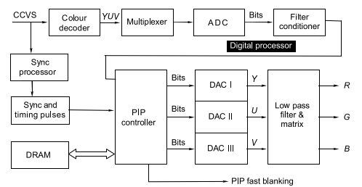
Block diagram of a typical picture-in-picture system

Slide 26
It converts the analog Y, U, V signals into bits which are stored in the dynamic random memory (DRAM) through a PIP controller.
This stored digital data can be read out for display.
The PIP controller demultiplexes the digitised Y, U and V data.
These data streams are fed to three DACs which give out analog Y, U and V signals.
The PIP controller also produces fast blanking pulses which are used to switch between the signals of the main picture and the insert picture.
After lowpass filtering, the Y, U, V signals pass through a resistive matrix to give R, G, B colour signals to produce a picture on the screen of the TV receiver.
The PIP controller is provided with vertical and horizontal sync pulses of both the pictures and also the timing pulses.

Slide 27
High Definition TV
Definition of a picture depends on the ability of the system to resolve very closely spaced tiny objects, so that they appear distinctly clear; and not appear as merged.
For example, hair of the eyebrows or moustache over the lips should not appear as a patch of hair, but should be distinctly visible as they are.
Similarly, wrinkles on the face and veins on the leaves should be clearly visible.
Thus, definition is related to resolution.
Resolution depends on the number of scanning lines per frame

Slide 28
Resolution also depends on the typical viewing distance which allows the distance between adjacent pixels to subtend an angle of 1’ ( 1/60 degree) at the eyes.
The system with 625 lines (25 frames per second) and 525 lines (30 frames per second) known as European and American systems, respectively are known as conventional or traditional, standard definition television systems, or simply SDTV.
The pursuit of higher resolution in different countries resulted to the agreed common world standard for High Definition Television (HDTV)

Slide 29
Agreed Standards for HDTV
1080 lines per frame (active lines)
Scanning may be chosen to be either interlaced (2:1) or progressive.
This option will not affect compatibility.
As the number of active lines per frame is 1080, the number of pixels contributing to resolution would be equal to 1080 x 1080 x 16/9 = 2073600.
25 frames per second in European camp and 30 frames per second in American camp to match with the frequencies of their Electric Mains Supply systems.
Aspect ratio of 16:9
The system shall be digital only

Slide 30
Enhanced Definition TV (EDTV)
This term defines specifications that produce a picture which is superior to that of SDTV but inferior to HDTV.
The term refers to devices capable of 525 or 625 lines per frame in progressive scanning on the screens with aspect ratio of 16:9.
EDTV broadcasts require less bandwidth than HDTV broadcasts and hence more channels are available in EDTV than in HDTV.
There is about 30% increase in definition in EDTV as compared to the SDTV system.

Slide 31
Ultra High Definition TV (UHDTV)
The Consumer Electronics Association (CEA) announced that the official term “Ultra HD” would be used for any display with a 16 x 9 ratio with at least 1 digital input cable carrying a minimum resolution of 3,840 x 2,160 square pixels.
Currently there are 2 forms of Ultra HD, 4K and 8K, both have an aspect ratio of 16:9.
4K Ultra HD (2160p) has a resolution of 3840 × 2160 (8.3 megapixels), which is roughly equivalent to 4K cinema or 4 times the number of pixels in Full HD format (1080p).
8K Ultra HD (4320p) produces an astonishing 7,680 × 4,320 pixel resolution (33.2 megapixels), which is roughly the equivalent of an IMAX film or 16 times the pixel resolution of Full HD (1080p).

Slide 32
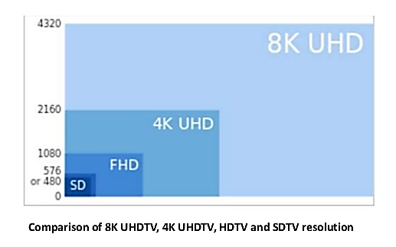

Slide 33
Ultra HDTV frame rates - 120, 60, 59.94, 50, 30, 29.97, 25, 24, and 23.976 frames per second
In addition to the significant upgrade in video quality, sound quality is also significantly increased with Ultra HDTV.
24 channels of audio can be used with 24 speakers, producing a difference comparable to the Ultra HD video resolution.
Advantages
Its pictures have more detail
Better image depth
Better colour handling
A more cinematic, immersive experience
It makes 3D better

Slide 34
Disadvantages
Not much content available
Wont see much of a difference if the screen is smaller than 50 inches
Expensive - 65" Class Q800T QLED 8K UHD HDR Smart TV is priced at $2,000 minimum.

